Slide 1

B.TECH CSE 7TH SEM
PROJECT
PRESENTATION
PRESENTED TO:
MR SANDEEP DAGAR (HOD)
PROJECT HEAD
PRESENTED BY:
KUSHAL SANGWAN (5218)

Slide 2

On Topic:
MEGA
SALES
ANALYSIS

Slide 3

PPTX
Overview
…
Data Analytics • Powerpoint
# TITLE
Objectives of the Project
Description of Our Data
Data Preparation
Exploratory Data Analysis
Conclusion
Tools Used

Slide 4



OBJECTIVES OF
THE PROJECT

Slide 5



Finding trends & patterns and solving problems. | Increase customer experience. | Increase revenue for the organization.

Slide 6


Slide 7
MEGA SALES ANALYSIS
SOURCE OF THE DATA: Kaggle, CSV file
SIZE OF THE DATA: Rows (observations): 11251
Columns (variables): 15
TYPE OF DATA: Mix-Type (Characters, Integers, Float)
VARIABLES: Gender, Customer Name, Product ID, State, Marital Status, Orders, etc.
Missing values: Status & Unnamed1 (We’ll clean them later)

Slide 8
DATA PREPARATION
• Data Importing: The first step in data preparation is importing your data into your Python environment. This could involve loading a CSV file, connecting to a database, or even scraping a website.
df = pd.read_csv('Mega Sales Data.csv', encoding= 'unicode_escape')

Slide 9
DATA PREPARATION
• Data Importing: The first step in data preparation is importing your data into your Python environment. This could involve loading a CSV file, connecting to a database, or even scraping a website.
df = pd.read_csv('Mega Sales Data.csv', encoding= 'unicode_escape')
• Data Cleaning: This step involves preparing your data for analysis. This could include dealing with missing or inconsistent data, removing duplicates, renaming the variables and correcting errors. Data cleaning is crucial because the quality of your data impacts the quality of your analysis.
df.dropna(inplace=True), df.rename(columns= {'Marital_Status':'Shaadi'})

Slide 10
DATA PREPARATION
• Data Importing: The first step in data preparation is importing your data into your Python environment. This could involve loading a CSV file, connecting to a database, or even scraping a website.
df = pd.read_csv('Mega Sales Data.csv', encoding= 'unicode_escape')
• Data Cleaning: This step involves preparing your data for analysis. This could include dealing with missing or inconsistent data, removing duplicates, renaming the variables and correcting errors. Data cleaning is crucial because the quality of your data impacts the quality of your analysis.
df.dropna(inplace=True), df.rename(columns= {'Marital_Status':'Shaadi'})
• Data Transformation: This could involve a wide range of operations, such as converting data types, creating new variables, etc..
df['Amount'] = df['Amount'].astype('int')

Slide 11
EXPLORATORY DATA ANALYSIS
Exploratory Data Analysis (EDA): EDA is an analysis approach that identifies general patterns in data, often visualizing it together.
EDA is an important first step in any data analysis.
EDA shows the relation between the variables provided in the data and to find the best method.
For visualization, certain types of graphs are used to present the information or pattern in an easy way. Graphs like barplot, countplot, histograms etc.

Slide 12
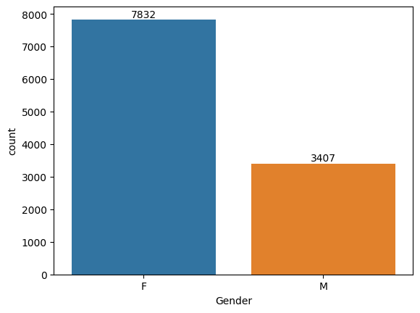
Gender:
Plotting a bar chart for Gender to see which gender has more orders and how much.
ax = sns.countplot(x = 'Gender',data = df)
for bars in ax.containers:
ax.bar_label(bars)

Slide 13
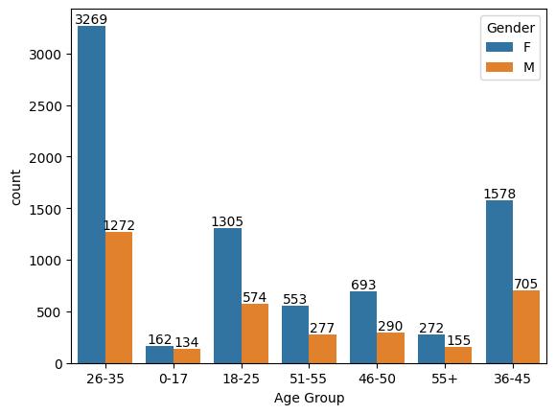
Age:
ax = sns.countplot(data = df, x = 'Age Group', hue = 'Gender')
for bars in ax.containers:
ax.bar_label(bars)
Finding which age group buys the most and which gender is dominant upon them.

Slide 14
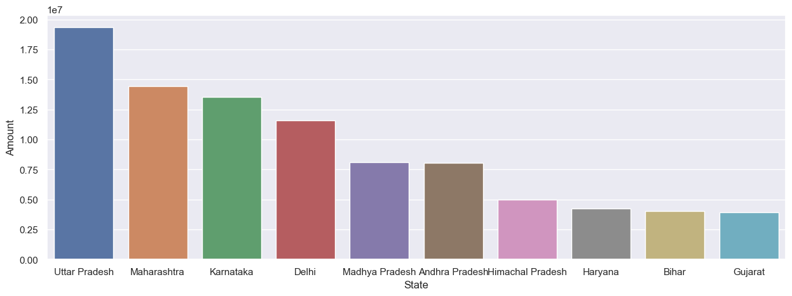
State:
Which state has the most purchasing power.
sales_state = df.groupby(['State'], as_index=False)['Amount'].sum().sort_values(by='Amount', ascending=False).head(10)
sns.set(rc={'figure.figsize':(15,5)})
sns.barplot(data = sales_state, x = 'State',y= 'Amount')

Slide 15
Conclusion:
1.
Patterns We Found:
From our analysis, we found that age group of 26-35 buys the most from which most of them are females. And the state of Uttar Pradesh (UP) has the most purchasing power.
🚺

Slide 16
Conclusion:
1.
Patterns We Found:
From our analysis, we found that age group of 26-35 buys the most from which most of them are females. And the state of Uttar Pradesh (UP) has the most purchasing power.
🚺
2.
How these results could benefit the organizations:
This information tells them which type of users to target to get the most profit. Where should the organization put the resources and effort for better results.
💵

Slide 17
Conclusion:
1.
Patterns We Found:
From our analysis, we found that age group of 26-35 buys the most from which most of them are females. And the state of Uttar Pradesh (UP) has the most purchasing power.
🚺
2.
How these results could benefit the organizations:
This information tells them which type of users to target to get the most profit. Where should the organization put the resources and effort for better results.
💵
3.
Recommendations:
Where it’s best for the organization to apply more effort to attract more users and provide best services so users won’t move to other competitors.
📃

Slide 18
TOOLS
USED

Slide 19

Visual Studio Code
Jupyter Notebook
Python
Excel
Visual Studio Code, a very useful IDE will be used here.
One of the most famous IDE & owned by Microsoft. It supports many programming languages for each purpose.
It is very reliable because of the extensions it supports which could help in all kinds of development.
Alternatives: Spyder IDE, PyCharm
VISUAL
STUDIO
CODE

Slide 20

Visual Studio Code
Jupyter Notebook
Python
Excel
The Jupyter Notebook is an open-source, web-based interactive environment that allows you to create and share documents.
You can write explanations, add images, and even run code all in the same document.
Jupyter Notebook supports over 40 programming languages, including Python, R, Julia, and Scala.
Alternatives: Google Collab
JUPYTER
NOTEBOOK

Slide 21

Visual Studio Code
Jupyter Notebook
Python
Excel
Python 3 is a high-level programming language that is known for its clear syntax and readability.
It supports multiple programming paradigms, including object-oriented, functional, and procedural programming.
Python is a popular language for data science because it is easy to learn, has a large and active community, offers powerful libraries for data analysis and visualization, and has excellent machine-learning libraries
Alternatives: R, Julia
PYTHON
3

Slide 22

Visual Studio Code
Jupyter Notebook
Python
Excel
Microsoft Excel is a spreadsheet software program that is part of the Microsoft Office suite.
It’s a powerful tool for data visualization and analysis.
Excel allows you to organize, manipulate, and manage all kinds of data.
Alternatives: Google Sheets, Libre Calc
EXCEL

Slide 23

- For Joining Me
That’s all for today.

